Slide 1
Digital Portfolio
STUDENT NAME: Abinesh J
REGISTER NO AND NMID:asunm1112401111058001
DEPARTMENT: computer science
COLLEGE: L. N. Government college, Madras University.

Slide 2
PROJECT TITLE
Digital portfolio using front end web development

Slide 3


AGENDA
Problem Statement
Project Overview
End Users
Tools and Technologies
Portfolio design and Layout
Features and Functionality
Results and Screenshots
Conclusion
Github Link
3/21/2024 Annual Review

Slide 4

PROBLEM STATEMENT
In the modern digital landscape, students and professionals often struggle to effectively present their skills, projects, and achievements through traditional resumes alone. Static resumes fail to provide interactivity, visual appeal, and real-time updates, which are essential for standing out in today’s competitive environment.
The lack of a structured and accessible platform prevents many from showcasing their creativity, technical expertise, and personal branding. To address this gap, a personal portfolio website is required—one that not only highlights academic and project work but also presents it in a visually engaging, responsive, and professional manner with smooth animations and user-friendly navigation.

Slide 5

PROJECT OVERVIEW
This project is a personal portfolio website designed to showcase my academic background, skills, and projects in a professional and interactive way. The website contains dedicated sections such as About Me, Projects, Skills, and Contact, making it easy for visitors to explore my profile. It provides a modern, responsive design that works across devices, ensuring accessibility and user-friendliness. The About Me section highlights my passion for technology and web development. The Projects section demonstrates hands-on work like responsive websites, quiz apps, and blog development. Overall, the portfolio serves as a digital platform to present my achievements, creativity, and technical expertise effectively.

Slide 6

WHO ARE THE END USERS?
This portfolio webpage is designed as a versatile platform to present personal achievements, skills, and projects in a structured and professional manner. It is especially useful for students who want to showcase academic projects and resumes online. Job seekers can share it with recruiters as a modern alternative to traditional resumes. Freelancers can use the site to present their skills and completed work to attract potential clients. Professionals can highlight their career achievements, expertise, and experiences in a visually engaging format. Overall, the portfolio serves as a dynamic digital identity, enhancing personal branding and career opportunities.

Slide 7

TOOLS AND TECHNIQUES
This portfolio webpage is built using HTML to define the structure, including sections like About Me, Projects, Skills, and Contact. CSS is used for styling, providing layouts, color themes, and responsive design for different devices. JavaScript adds interactivity through smooth navigation, animations, and form validation in the Contact section. The development was carried out using a modern code editor such as Visual Studio Code (VS Code) and online tools like CodePen for quick testing. The website is lightweight, user-friendly, and optimized for accessibility. Finally, the project is hosted on GitHub Pages, making it easily accessible to recruiters, clients, and peers.

Slide 8
POTFOLIO DESIGN AND LAYOUT
This portfolio webpage is designed with a clean and structured layout to showcase personal and professional details. The Home/About Me section introduces background information and highlights key strengths. The Projects section presents academic and personal projects with clear descriptions. The Skills section outlines technical and professional abilities in an organized format. The Contact section provides an easy way for visitors, recruiters, or clients to connect. With a responsive layout, the website adapts seamlessly to both mobile and desktop devices, ensuringaccessibility
8

Slide 9
FEATURES AND FUNCTIONALITY
This portfolio webpage features a Home/About Me section to introduce personal details and strengths. The Projects section displays academic and personal projects with clear descriptions. The Skills section highlights technical and professional abilities in a structured way. The Contact section allows visitors to connect through forms or links. It is built with a responsive design, adapting smoothly to both mobile and desktop devices. Interactive elements like navigation menus and animations enhance user experience and engagement.

Slide 10
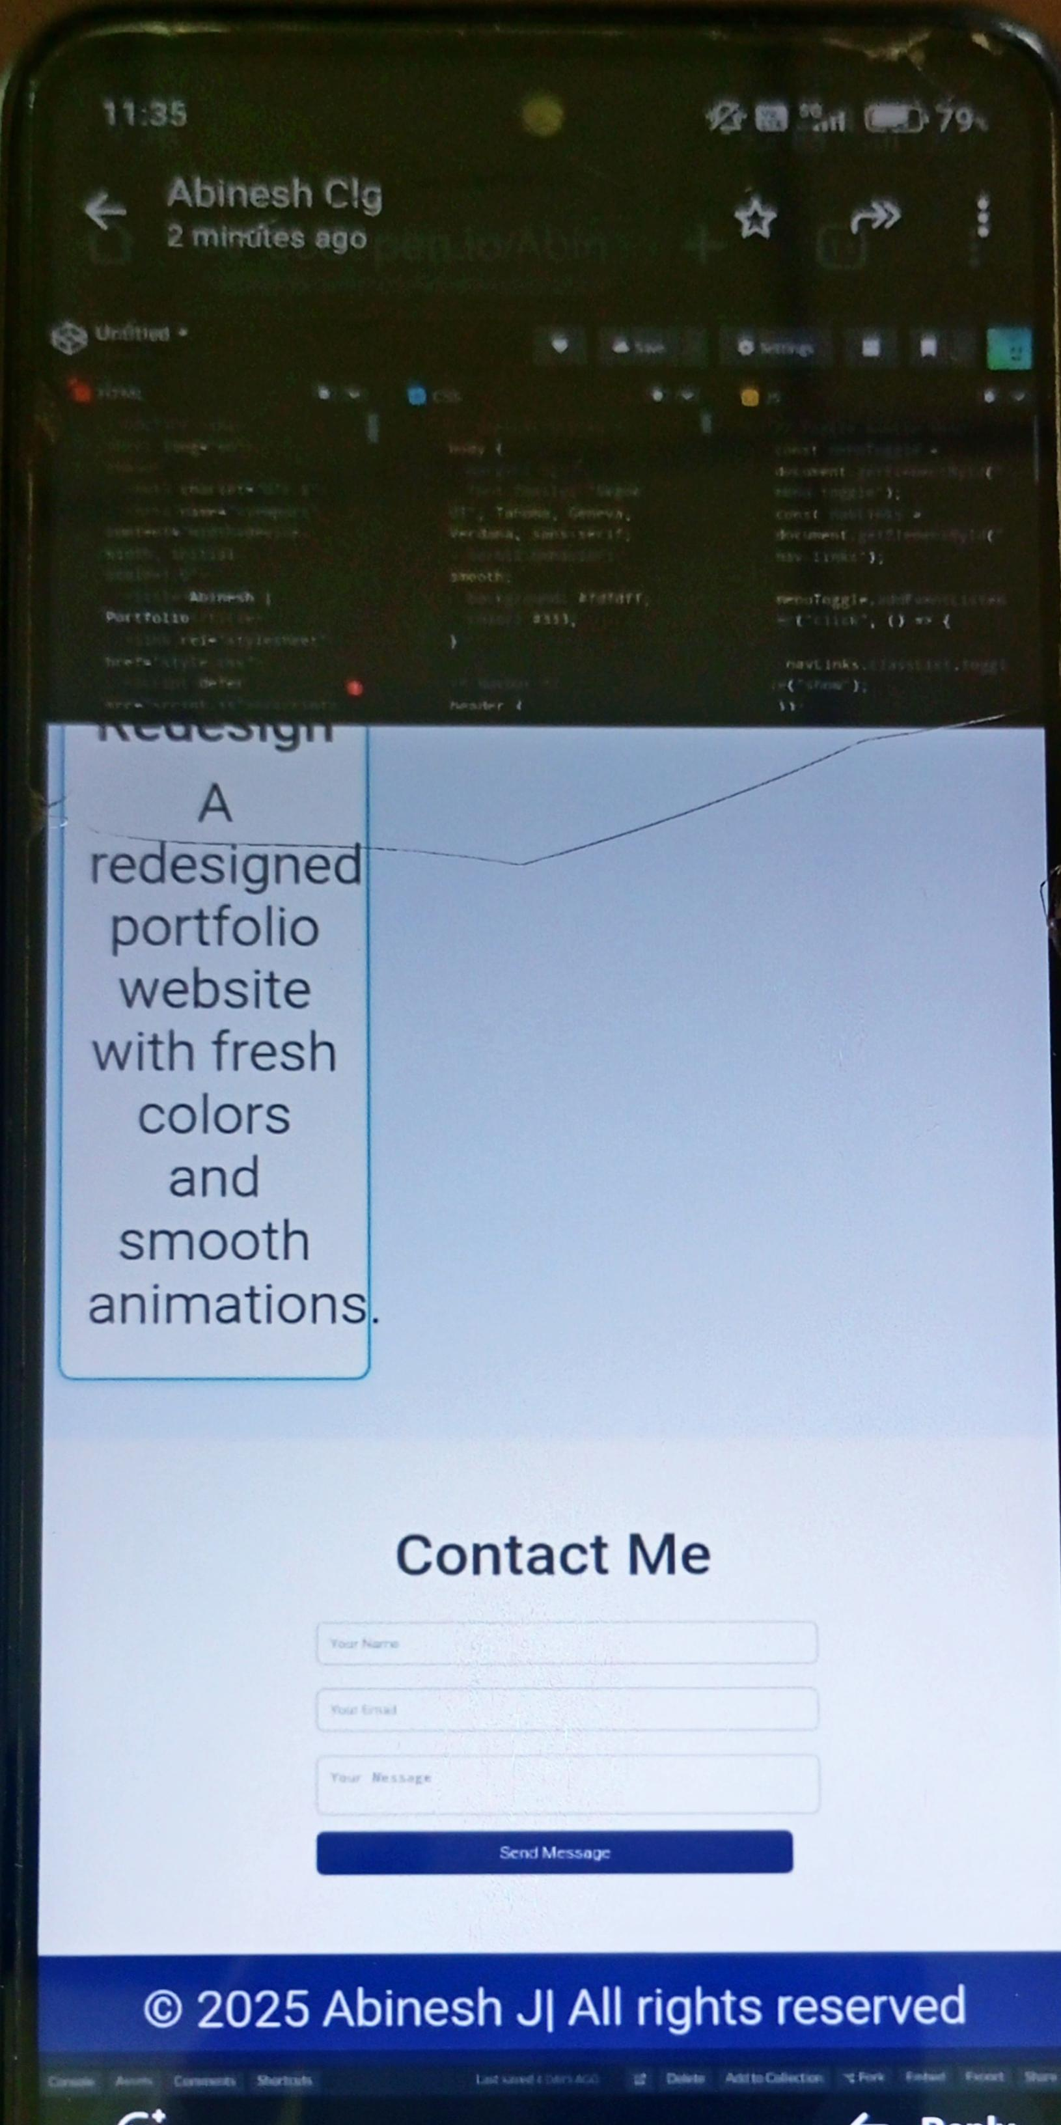
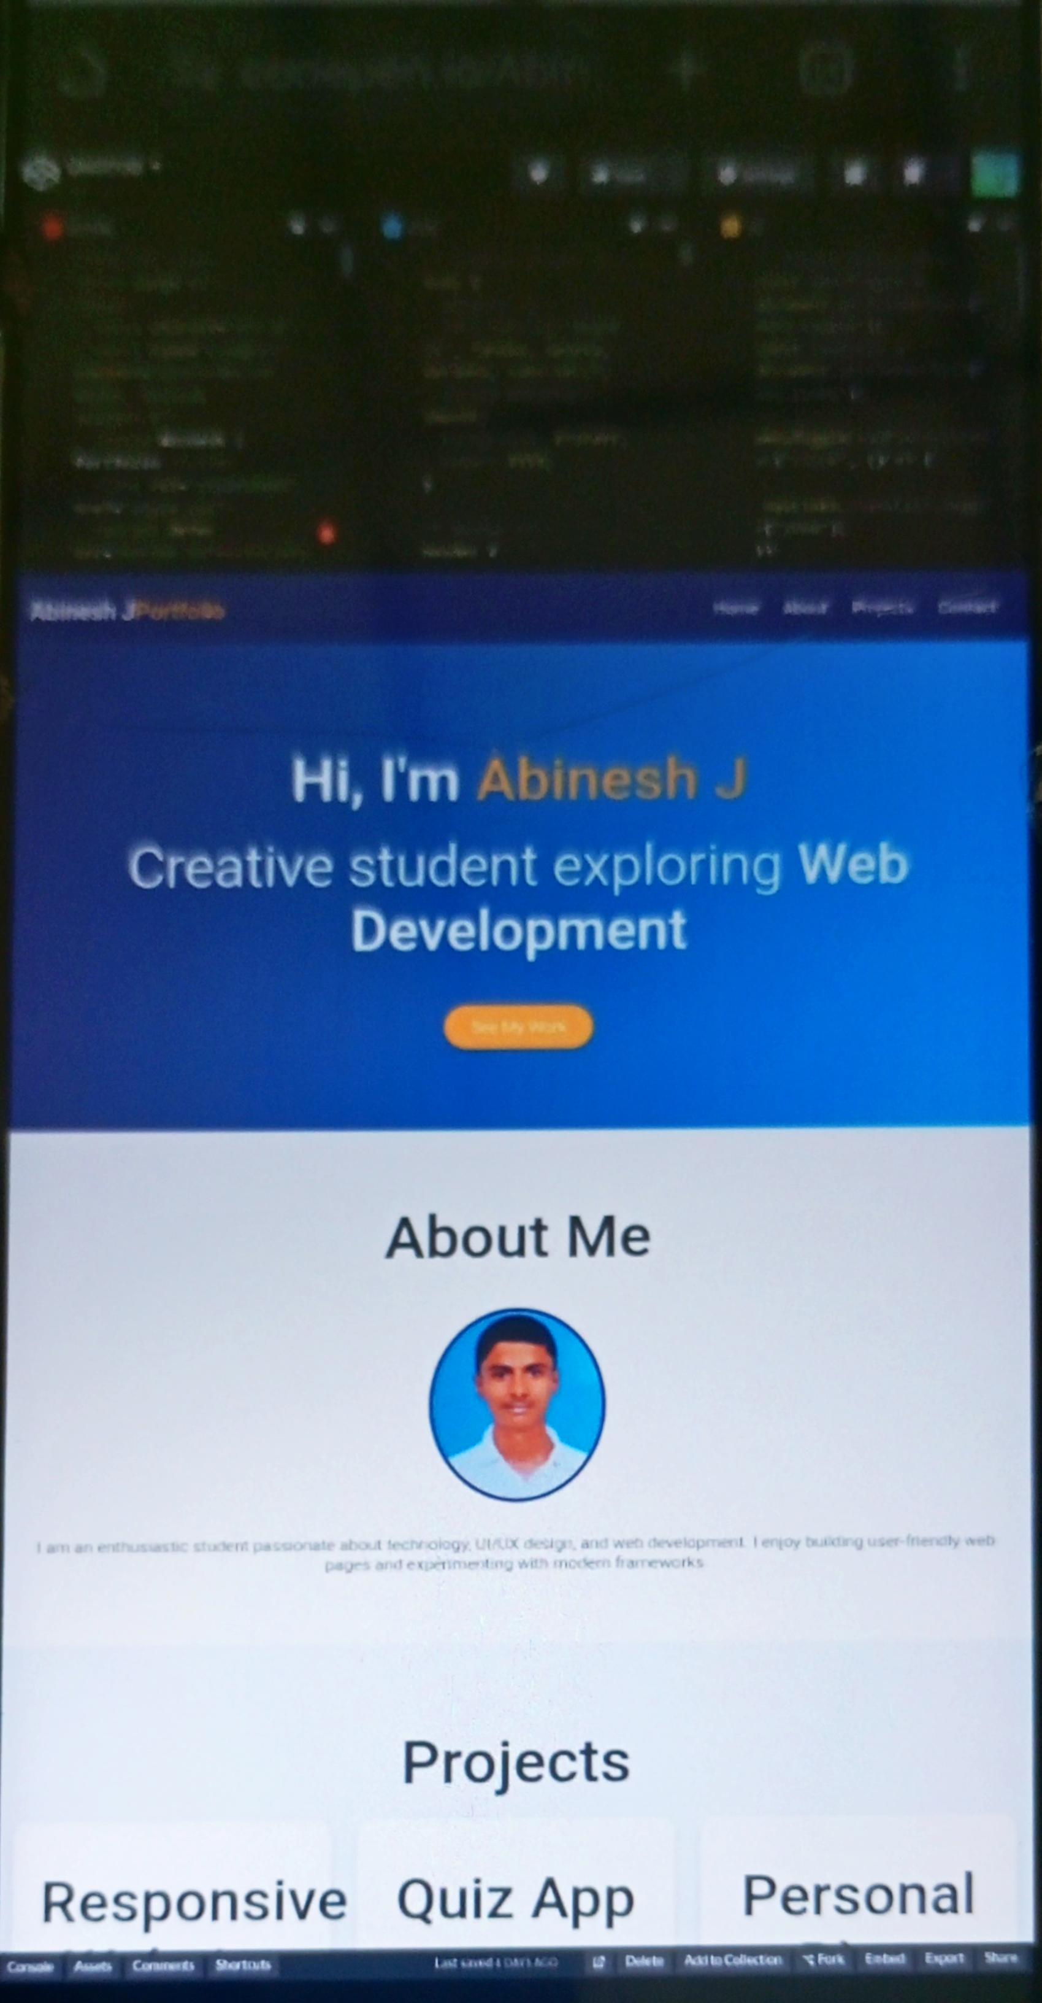
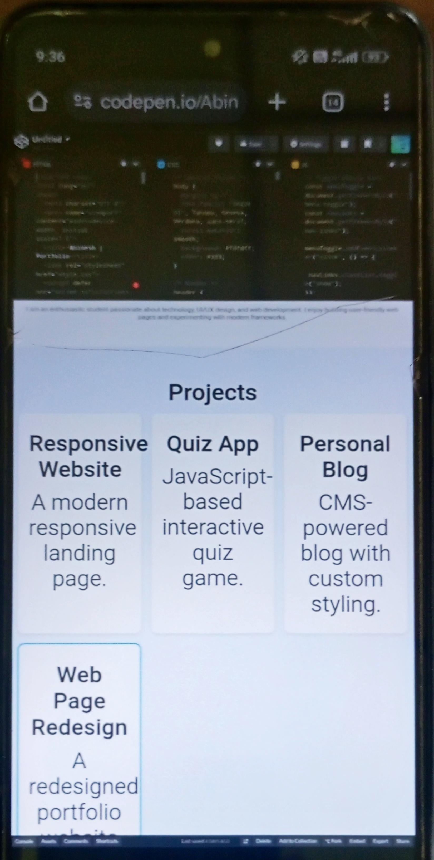

RESULTS AND SCREENSHOTS
3/21/2024 Annual Review
10

Slide 11
CONCLUSION
This portfolio webpage successfully highlights my academic background, skills, and personal projects in a professional manner. It provides a structured and interactive platform that goes beyond the limitations of traditional resumes. The responsive design ensures accessibility across devices, making it convenient for recruiters, clients, and peers. By showcasing my projects and skills, the website serves as a strong tool for personal branding and career growth. It also benefits students, job seekers, and professionals by acting as an example of how to build a digital presence. Overall, the project demonstrates creativity, technical expertise, and the importance of maintaining an online professional identity.
11

